Slide 1
Artificial Intelligence – IT Issues & Technology
Team 2
Irfan Olia
Harshit Joshi
Siddharth Gulati
Parth Maheshwari

Slide 2
Table of Contents
What is AI
Subsets of AI
Categories of AI
Issues with AI
Constraints of AI
Business Drivers for AI
Applications of AI
SWOT Analysis
ANSOFF Matrix
Mintzberg’s Five P Strategy
Envisioned Target State
Analysis: Risks
Recommendations
References
Thank you!

Slide 3
What is Artificial Intelligence (AI)?
AI is a computer Science that is focused on building smart & intelligent machines
Intelligence developed by machines & computers to do tasks that are usually done by humans
Notes:
Irfan Olia

Slide 4
7 Subsets of Artificial Intelligence
Machine Learning - Automatically learn from experience without being explicitly programmed.
Machine Vision – Ability to see by employing video cameras & Digital signal processing.
Natural Language processing – Ability to understand text like human beings.
Deep Learning – Machine Learning techniques that teaches computers to learn like humans.
Robotics – Employ flexibility and learning capabilities in robotic solutions.
Expert System – Emulate decision making capabilities of a human expert.
Speech Recognition - Ability to understand and learn human speech and accents.
Notes:
Irfan Olia

Slide 5
4 Categories of AI
Static AI - Explicitly programmed and manually trained parameters for example predict probability using decision tree.
Dynamic AI - Automatically & Periodically retain parameters and adapt based on input. Start with historical patterns with subsequent ability to learn and predict. Neural networks
Auto AI - Automatically change basic structure like input variables and hyper parameters
Cognitive AI - Autonomous decision making & take actions accordingly even on untrained subjects
Notes:
Irfan Olia

Slide 6
Issues with Artificial Intelligence
Unfairness – Unfairly producing results that systematically favors one outcome over the other
Unintended Cognitive Biasness – Creating biased algorithms due to unintended cognitive biases
Targeting & Profiling of racial groups - Racial or Prejudicial data sets used to train the ML algorithms
Systematic disadvantage – Outcomes that puts certain groups of people under disadvantage.
Lack of Transparency - Lack of transparency in how and who created the algorithms
Trust and Reliability concerns – People not having trust in the outcome of the AI Predictions
Lack of diverse representation – Diverse group of representative not involved in defining the rules
Lack of Explainability – Overall logic patterns, underlying theory of model cannot be explained.
Accountability – everyone who is involved in creating AI solution needs to take responsibility
Notes:
Irfan Olia

Slide 7
Constraints of AI
Inability to Think Abstractly
Moral and Ethical Limits
Framework Must Be Clearly Defined
Transparency Problem of Machine Decisions
Simulation Limit of Emotions
Data access and privacy constraints
Notes:
Irfan Olia

Slide 8
Business Drivers for AI
To compete in a rapidly evolving technology landscape
Strengthen Internal processes to attain operational efficiencies
Improve strategic and tactical business decision making
Serve clients with better customer service
Develop better products & Services by understanding customer needs and wants
Create economic value for the business
Predict future trends
Notes:
Irfan Olia

Slide 9
Popular Applications of AI
Medicine (treatments, analysis & forecasts)
Stock market and financial services (data management, fraud prevention)
Virtual Reality Video Games
Automation (autonomous driver assistance systems, smart devices and appliances)
Smart Security Systems
Speech and word processing in machine learning.
Automated Chatbots using text translations or dialogues
Face Recognition applications
ECommerce
Education (Smart content)
Marketing
Notes:
Irfan Olia

Slide 10
SWOT Analysis
STRENGTHS:
Ability to Work 24x7
Always Learning and Becoming Better
Major Advantage for R&D
Can Fit into Any Environment
WEAKNESSES:
Price
Technical Expertise
Taking up the Responsibility
Computational Speed and Storage
​
Automation ​
Behaviour Prediction and Decision Ma-king​
Big Data
Easy to make the exsisting technology smart than developing a new one
Legal Challenges
Safety and Ethical Usage
AI Myths
Control
OPPORTUNITIES:
THREATS:
Notes:
Harshit Joshi

Slide 11
ANSOFF Matrix
Existing Products
New Products
Incremental Innovation
Reduction in Prices
Product Development
Market Penetration
Radical Innovation
Existing Markets
Creating a compatible AI
Focusing on product strengths
Differential Pricing
Having major funding and time
Riskiest strategy especially with AI
Market Development
Diversification
New Markets
Notes:
Harshit Joshi

Slide 12
Mintzberg’s Five P Strategy
Perspective
Aligning AI with the Mission and Vision of the organization.
Position
Looking at the goal of the company and market position. This helps to determine the level of integration is required of the product or service with AI.
Plan
Making the objectives SMART. Most importantly focusing on the adaptation of AI.
Ploy
Staying updated with the competitors and mainly focusing on how productive the current product would be compared to the existing competitors.
Pattern
Looking at the past strategies and their performance and evaluating the current strategy. AI would bring certain changes into the product or service but the core benefit that one company is willing to provide would always remain the same.
Notes:
Harshit Joshi

Slide 13

Envisioned Target State
The pace of change has been unprecedented in the sector, and it promises to continue in the same vein in the years to come
By 2030, AI will likely no longer be getting adopted with simple scenarios and applications
JARVIS-Like AI Assistants Will Become Commonplace
AI-Human Collaboration will become a critical part of day-to-day business operations, supporting employees' creative activities, generating new ideas, and tackling previously unattainable innovations
Autonomous Automobiles Might Drive Better Than Humans
AI Will Improve The Quality Of Medical Treatments
Notes:
Siddharth

Slide 14
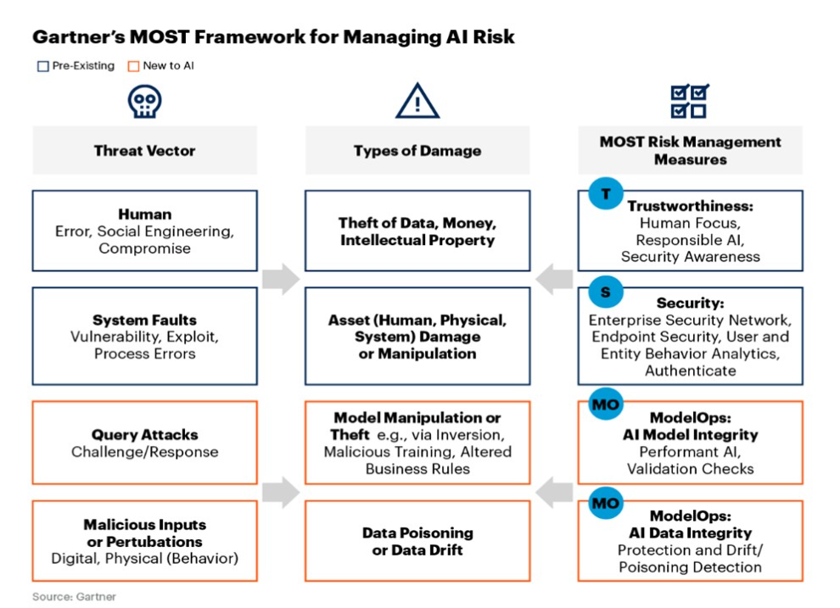
Analysis: Risks
According to a recent Gartner survey, data privacy and security is viewed as a primary barrier to AI implementations
AI operates as a “black box” in most organizations. Gaining clarity about AI models is the first step organizations must take to gain the context needed for risk management
According to Gartner's MOST framework
Notes:
Siddharth

Slide 15
Alternatives: Recommendation
Synthetic intelligence (SI), sometimes referred to as engineered intelligence, is a refinement of the concept of artificial intelligence (AI)
John Haugeland proposes an analogy with simulated diamonds and synthetic diamonds—only the synthetic diamond is truly a diamond
Another reason for eschewing the adjective “artificial” is that it connotes simulated intelligence. Contrary to another common misunderstanding, the goal is not to simulate intelligence. The goal is to understand real (natural or synthetic) intelligent systems by synthesizing them.
Notes:
Siddharth
Another analogy - A simulation of an earthquake isn’t an earthquake; however, we want to actually create intelligence, as you could imagine creating an earthquake

Slide 16
References
https://www.simplilearn.com/tutorials/artificial-intelligence-tutorial/artificial-intelligence-applications
https://builtin.com/artificial-intelligence
https://futureoflife.org/background/benefits-risks-of-artificial-intelligence/
https://www.cloudmoyo.com/blog/ai-ml-automation/top-10-potential-ai-artificial-intelligence-problems/#:~:text=One%20of%20the%20biggest%20Artificial,sensor%20data%20as%20its%20input.&text=The%20algorithm%20becomes%20strong%20and,isn't%20fed%20into%20it.
Top 5 Priorities for Managing AI Risk Within Gartner's MOST Framework

Slide 17
Questions? Comments! & Concerns :(

